Slide 1

8th Grade Math: Pre-Algebra
Unit 11, Lesson 5 Scatter Plots and Lines of Fit Volume 2, pg. 200

Slide 2


Benchmarks
MA.8.DP.1.2
Given a scatter plot within a real-world context, describe patterns of association.
MA.8.DP.1.3
Given a scatter plot with a linear association, informally fit a straight line.
volume 2, pg. 200

Slide 3
Integrated Mathematical Thinking and Reasoning Standards
MA.K12.MTR.4.1 Engage in discussions that reflect on the mathematical thinking of self and others.
MA.K12.MTR.5.1 Use patterns and structure to help understand and connect mathematical concepts.
MA.K12.MTR.6.1 Assess the reasonableness of solutions.
MA.K12.MTR.7.1 Apply mathematics to real-world contexts.
volume 2, pg. 200

Slide 4

Learning Targets
I can describe patterns of associations in data on a scatter plot.
I can informally fit a straight line to data on a scatter plot.
volume 2, pg. 200

Slide 5

Warm-Up
volume 2, pg. 201

Slide 6
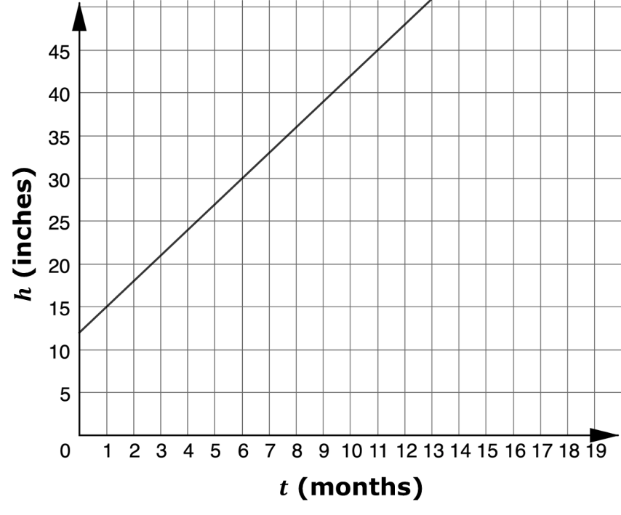

11.5.1 Warm-Up: Bell Work
The graph shows the height in inches, $h$, of a bamboo plant $t$ months after it has been planted.
What is the slope of the line?
Interpret the slope in this context.
The $y$-intercept of the line is $12$. Interpret the meaning of the $y$-intercept in context.
volume 2, pg. 201

Slide 7

Collaboration
volume 2, pg. 201

Slide 8

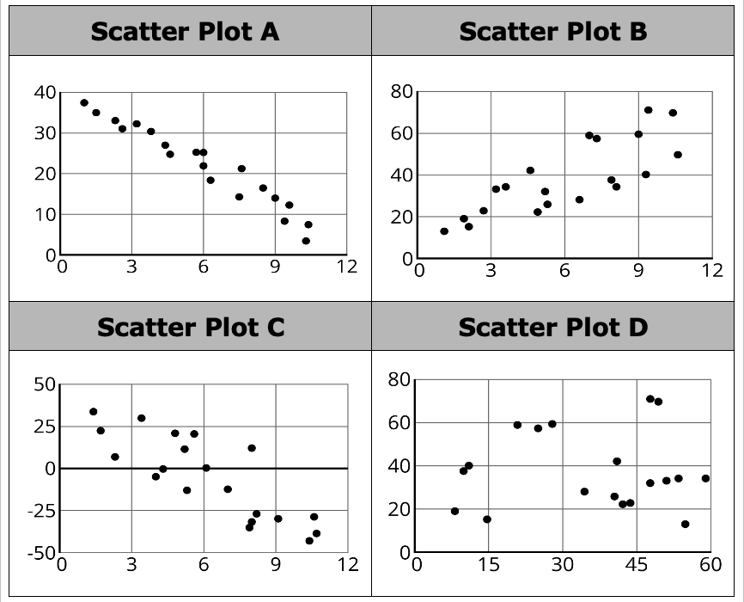
11.5.2 Collaboration: Patterns of Association
Four scatter plots are shown.
volume 2, pg. 201

Slide 9
Describe the direction of the linear association between the two variables in each scatter plot.
Scatter Plot | Direction of the Association
A
B
C
D
Explain which of the scatter plots does not belong based on the strength of the linear association between the two variables.
Discuss with your partner whether any of the scatter plots appear to have any outliers.
volume 2, pg. 201

Slide 10
Use a straightedge to draw a line that models the linear relationship between the two variables on each scatter plot.
Compare your lines with your partner’s. Discuss any differences and make revisions to your lines, if necessary.
volume 2, pg. 201

Slide 11

Explain which of the scatter plots does not belong based on the $y$-intercept of the lines you drew to model the linear relationships.
Explain which of the scatter plots does not belong based on the slope of the lines you drew to model the linear relationships.
volume 2, pg. 201

Slide 12

Activity
volume 2, pg. 202

Slide 13

11.5.3 Activity: Informally Fitting Lines to Data
Your teacher will give you and your partner a scatter plot and information about the relationship it models.
Record the letter of the provided scatter plot.
Scatter Plot _______
Describe any patterns of association.
volume 2, pg. 202

Slide 14
Work with your partner to use a straightedge to draw a line that models the relationship between the two variables on the scatter plot.
Explain how the slope of your line of fit relates to the patterns of association described in part b.
volume 2, pg. 202

Slide 15
Find a group with the same lettered scatter plot as you.
Compare and contrast both groups’ work. Record your observations on the Venn diagram.
Both groups had the same scatter plot. How would you explain any differences in your work?
Explain which group’s line fits the data better.
volume 2, pg. 203

Slide 16

Wrap-Up
volume 2, pg. 203

Slide 17
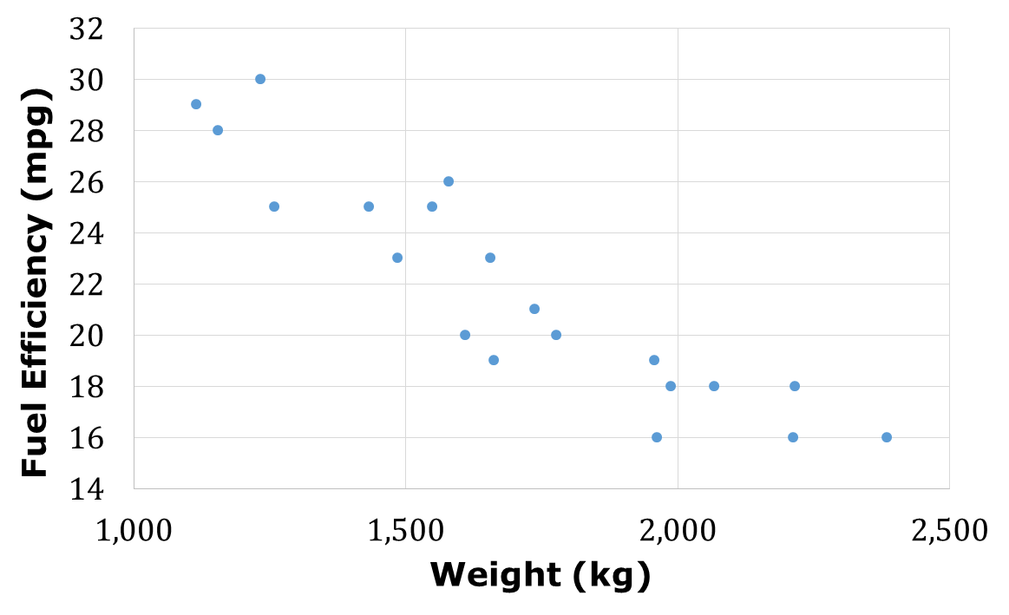
11.5.4 Wrap-Up: Ticket Out the Door
The scatter plot shows the relationship between a car’s weight in kilograms (kg) and its fuel efficiency in miles per gallon (mpg).
Informally fit a line to the data using a straightedge.
Describe how the slope of your line relates to the strength and direction of the association between the weight and fuel efficiency of a car.
volume 2, pg. 203

